Slide 1
SoundScape - Ambient Sound Generator

Slide 2
agenda
Introduction
Key Features
Technology Stack
Tools & Deployment
Workflow
Future Aspects
Conclusion

Slide 3
Introduction
Our web app offers a personalized escape into relaxation and focus.
Users can mix soothing sounds like rain, ocean waves, and crackling fireplaces to create their perfect ambiance.
They can save favorite combinations, build custom playlists, and enjoy a calming atmosphere tailored just for them.
Admins can easily add new sound categories, ensuring fresh experiences for everyone.

Slide 4
Key Features
🎵 Custom Sound Mixing: Combine sounds like rain, ocean waves, and crackling fire to create unique atmospheres.
⭐ Personalized Playlists: Save favorite mixes and organize them into custom playlists.
🔒 User Authentication: Secure login
🎚️ Real-Time Sound Control: Adjust volume for each sound to fine-tune the mix. 📁 Sound Management: User can add, update, or remove sound categories. 📱 Responsive Design : You can use this any device

Slide 5
Technology Stack
🌐 Frontend: HTML, CSS, JavaScript, Tailwind CSS.
⚙️ Backend: Node.js,Express.js, REST APIs.
🛢️ Database: MongoDB-NoSQL database
🔐 Authentication: Firebase Auth / JWT: Secure user authentication

Slide 6
Tools & Deployment
VS Code: Development environment.
Postman: API testing.
GitHub: Version control and collaboration.
Vercel/Render: Deploying the web app.

Slide 7
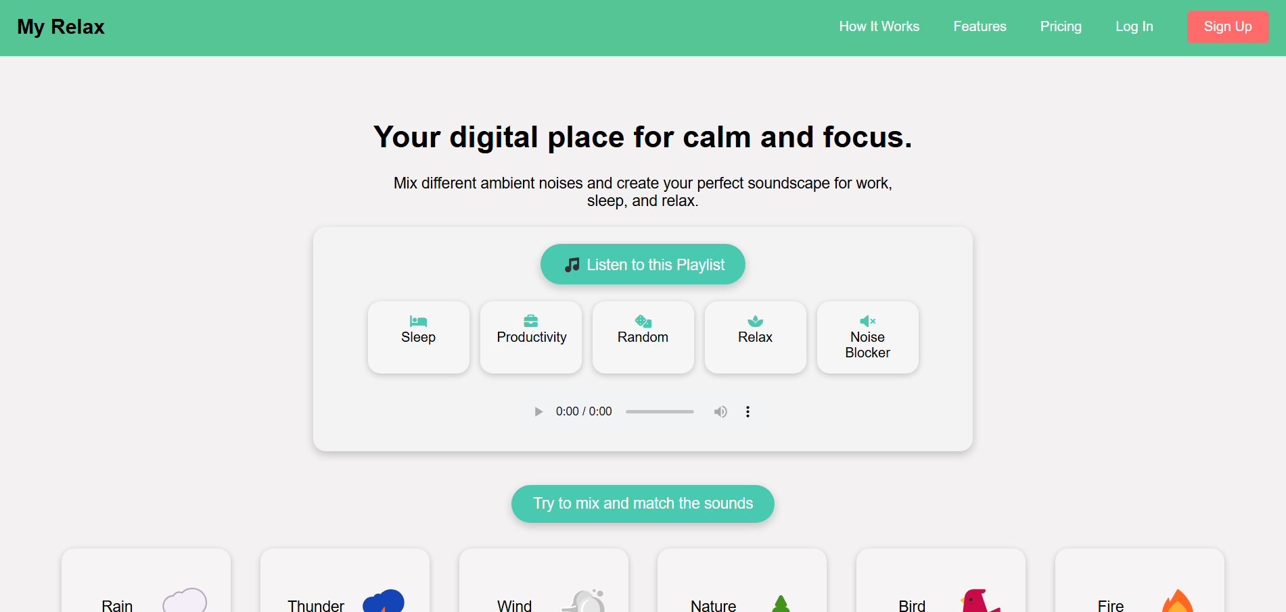
Workflow
User interacts with the frontend → Requests are sent to the backend → Backend retrieves/stores data from the database and serves audio from cloud storage → Results are sent back to the frontend.

Slide 8
Future Aspects
🌍 Community Playlists: Allow users to share and explore public sound mixes created by others.
📱 Mobile App: Develop native apps for iOS and Android to expand accessibility.
🌐 AI-Powered Recommendations: Suggest sound combinations based on user preferences and listening history.
🔊 Live Soundscapes: Stream real-time nature sounds from different parts of the world.
🗂️ Offline Mode: Enable downloading favorite mixes for offline use.
🚀 Subscription Model: Offer premium features like exclusive sounds and ad-free experiences.

Slide 9
Conclusion
The Relaxing Sound Mixer offers a personalized way to unwind, focus, and relax through custom soundscapes and playlists. It’s built for simplicity, scalability, and future growth, ensuring a soothing experience for every user

Slide 10
Thank you…

